Slide 1
Sorting & Searching Technique

Slide 2
Introduction to Sorting
Sorting is nothing but arranging the data in ascending or descending order. The term sorting came when humans realized the importance of searching quickly.
There are so many things into the real life that need to search for, like a particular record in database, roll numbers in merit list, a particular telephone number in telephone directory, a particular page in a book etc. All this would have been a mess if the data was kept unordered and unsorted, but fortunately the concept of sorting came into existence, making it easier for everyone to arrange data in an order, hence making it easier to search.
Sorting arranges data in a sequence which makes searching easier.

Slide 3
Sorting Efficiency:
The two main criteria's to judge which algorithm is better than the other have been:
Time taken to sort the given data.
Memory Space required to do so.
Different Sorting Algorithms:
There are many different techniques available for sorting, differentiated by their efficiency and space requirements. Following are some sorting techniques which we will be covering in next few tutorials.
Bubble Sort , Insertion Sort,
Selection Sort, Quick Sort,
Merge Sort, Heap Sort

Slide 4
An array using Bubble sort technique

Slide 5
Bubble Sort Algorithm
Bubble Sort is a simple algorithm which is used to sort a given set of n elements provided in form of an array with n number of elements. Bubble Sort compares all the element one by one and sort them based on their values.
If the given array has to be sorted in ascending order, then bubble sort will start by comparing the first element of the array with the second element, if the first element is greater than the second element, it will swap both the elements, and then move on to compare the second and the third element, and so on.
If we have total n elements, then we need to repeat this process for n-1 times.
It is known as bubble sort, because with every complete iteration the largest element in the given array, bubbles up towards the last place or the highest index, just like a water bubble rises up to the water surface.
Sorting takes place by stepping through all the elements one-by-one and comparing it with the adjacent element and swapping them if required.

Slide 6
Implementing Bubble Sort Algorithm
Following are the steps involved in bubble sort(for sorting a given array in ascending order):
Starting with the first element(index = 0), compare the current element with the next element of the array.
If the current element is greater than the next element of the array, swap them.
If the current element is less than the next element, move to the next element. Repeat Step 1.
Let's consider an array with values {5, 1, 6, 2, 4, 3}
Pictorial representation of how bubble sort will sort the given array:

Slide 7
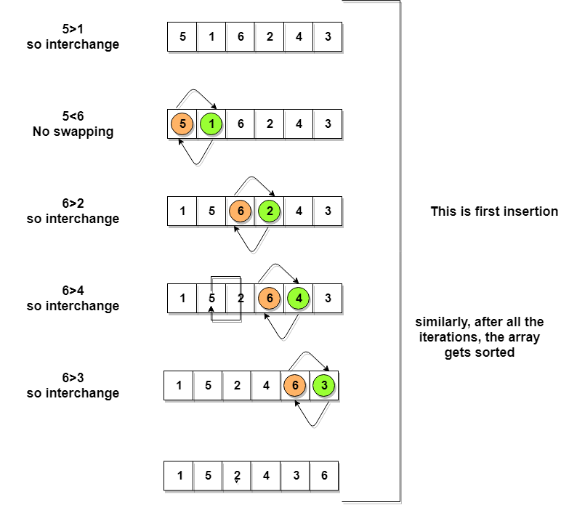

Slide 8
Algorithm
Assume list is an array of n elements. We further assume that swap function swaps the values of the given array elements.
begin BubbleSort(list)
for all elements of list
if list[i] > list[i+1]
swap(list[i], list[i+1])
end if
end for
return list
end BubbleSort

Slide 9
#include <stdio.h>
#define MAXSIZE 10
void main()
{
int array[MAXSIZE];
int i, j, num, temp;
printf("Enter the value of num \n");
scanf("%d", &num);
printf("Enter the elements one by one \n");
for (i = 0; i <num; i++)
{
scanf("%d", &array[i]);
}

Slide 10
printf("Input array is \n");
for (i = 0; i <num; i++)
{
printf("%d\n", array[i]);
}
/* Bubble sorting begins */
for (i = 0; i <num; i++)
{
for (j = 0; j < (num - i - 1); j++)
{
if (array[j] > array[j + 1])
{
temp = array[j];
array[j] = array[j + 1];
array[j + 1] = temp;
} } }

Slide 11
printf("Sorted array is...\n");
for (i = 0; i <num; i++)
{
printf("%d\n", array[i]);
}
}

Slide 12
Algorithm using Selection Sort Technique

Slide 13
Selection sort is one of the simplest sorting algorithms. It is similar to the hand picking where take the smallest element and put it in the first position and the second smallest at the second position and so on. It is also similar. First check for smallest element in the array and swap it with the first element of the array. Again, check for the smallest number in a subarray excluding the first element of the array as it is where it should be (at the first position) and put it in the second position of the array. And then continue repeating this process until the array gets sorted.
The time complexity of selection sort is (O(n²)).

Slide 14
Following steps to perform selection sort:
Start from the first element in the array and search for the smallest element in the array.
Swap the first element with the smallest element of the array.
Take a subarray (excluding the first element of the array as it is at its place) and search for the smallest number in the subarray (second smallest number of the entire array) and swap it with the first element of the array (second element of the entire array).
Repeat the steps 2 and 3 with new subarrays until the array gets sorted.

Slide 15
Algorithm:
Step 1 − Set MIN to location 0
Step 2 − Search the minimum element in the list
Step 3 − Swap with value at location MIN
Step 4 − Increment MIN to point to next element
Step 5 − Repeat until list is sorted
// Sort an arr[] of size n Selection_Sort() Loop from i = 1 to n-1. ……a) Pick element a[i] and select it into sorted sequence a[0…i-1] or a[min]

Slide 16
Initial array
16 | 19 | 11 | 15 | 10 | 12 | 14
First iteration
16 | 19 | 11 | 15 | 10 | 12 | 14
10 | 19 | 11 | 15 | 16 | 12 | 14
Second iteration
10 | 19 | 11 | 15 | 16 | 12 | 14
10 | 11 | 19 | 15 | 16 | 12 | 14
Third iteration
10 | 11 | 12 | 15 | 16 | 19 | 14
10 | 11 | 12 | 14 | 16 | 19 | 15

Slide 17
Fourth iteration
10 | 11 | 12 | 15 | 16 | 19 | 14
10 | 11 | 12 | 14 | 16 | 19 | 15
Fifth iteration
10 | 11 | 12 | 14 | 16 | 19 | 15
10 | 11 | 12 | 14 | 15 | 19 | 16
Sixth iteration
10 | 11 | 12 | 14 | 15 | 19 | 16
10 | 11 | 12 | 14 | 15 | 16 | 19
Final iteration
10 | 11 | 12 | 14 | 15 | 16 | 19

Slide 18
#include <stdio.h>
void selection_sort();
int a[30], n;
void main()
{
int i;
printf("\nEnter size of an array: ");
scanf("%d", &n);
printf("\nEnter elements of an array:\n");
for(i=0; i<n; i++)
scanf("%d", &a[i]);
selection_sort();
printf("\n\nAfter sorting:\n");
for(i=0; i<n; i++)
printf("\n%d", a[i]);

Slide 19
getch();
}}
void selection_sort()
{
int i, j, min, temp;
for (i=0; i<n; i++)
{
min = i;
for (j=i+1; j<n; j++)
{
if (a[j] < a[min])
min = j; }
temp = a[i];
a[i] = a[min];
a[min] = temp;
} }

Slide 20
Algorithm using Insertion Sort Technique

Slide 21
This is an in-place comparison-based sorting algorithm. Here, a sub-list is maintained which is always sorted. For example, the lower part of an array is maintained to be sorted. An element which is to be inserted in this sorted sub-list, has to find its appropriate place and then it has to be inserted there. Hence the name, insertion sort.
The array is searched sequentially and unsorted items are moved and inserted into the sorted sub-list (in the same array). This algorithm is not suitable for large data sets as its average and worst case complexity are of Ο(n²), where n is the number of items.

Slide 22
Algorithm:
Step 1 − If it is the first element, it is already sorted. return 1;
Step 2 − Pick next element
Step 3 − Compare with all elements in the sorted sub-list
Step 4 − Shift all the elements in the sorted sub-list that is greater than the value to be sorted
Step 5 − Insert the value
Step 6 − Repeat until list is sorted
Algorithm: // Sort an arr[] of size n insertionSort(arr, n) Loop from i = 1 to n-1. ……a) Pick element arr[i] and insert it into sorted sequence arr[0…i-1]
Next Insertion Sort Works:

Slide 23





We take an unsorted array for our example.
Insertion sort compares the first two elements.
It finds that both 14 and 33 are already in ascending order. For now, 14 is in sorted sub-list.
Insertion sort moves ahead and compares 33 with 27.
And finds that 33 is not in the correct position.

Slide 24



It swaps 33 with 27. It also checks with all the elements of sorted sub-list. Here we see that the sorted sub-list has only one element 14, and 27 is greater than 14. Hence, the sorted sub-list remains sorted after swapping.
By now we have 14 and 27 in the sorted sub-list. Next, it compares 33 with 10.
These values are not in a sorted order.

Slide 25





So we swap them.
However, swapping makes 27 and 10 unsorted.
Hence, we swap them too.
Again we find 14 and 10 in an unsorted order.
We swap them again. By the end of third iteration, we have a sorted sub-list of 4 items.

Slide 26
This process goes on until all the unsorted values are covered in a sorted sub-list. Now we shall see some programming aspects of insertion sort.
Next Insertion Sort Program :

Slide 27
#include <stdio.h>
#define MAX 100
int main()
{
int arr[MAX],limit;
int i,j,temp;
printf("Enter total number of elements: ");
scanf("%d",&limit); /*Read array*/
printf("Enter array elements: \n");
for(i=0; i<limit; i++)
{
printf("Enter element %3d: ",i+1);
scanf("%d",&arr[i]);
}

Slide 28
/*sort elements in Ascending Order*/
for(i=1; i<(limit); i++)
{ j=i;
while(j>0 && arr[j]<arr[j-1])
{
temp=arr[j];
arr[j]=arr[j-1];
arr[j-1]=temp;
j--; } }
printf("Array elements in Ascending Order:\n");
for(i=0; i<limit; i++)
printf("%d ",arr[i]);
printf("\n");

Slide 29
/*sort elements in Descending Order*/
for(i=1; i<(limit); i++)
{ j=i;
while(j>0 && arr[j]>arr[j-1])
{
temp=arr[j];
arr[j]=arr[j-1];
arr[j-1]=temp;
j--; } }
printf("Array elements in Descending Order:\n");
for(i=0; i<limit; i++)
printf("%d ",arr[i]);
printf("\n");
return 0;}

Slide 30
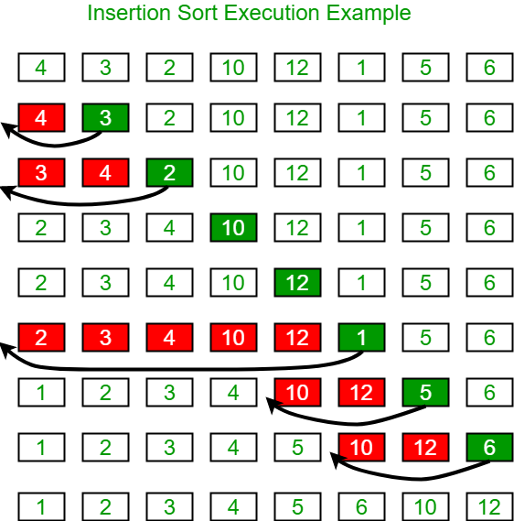

Slide 31
Another Insertion SortbExample: 12, 11, 13, 5, 6
Let us loop for i = 1 (second element of the array) to 5 (Size of input array)
i = 1. Since 11 is smaller than 12, move 12 and insert 11 before 12 11, 12, 13, 5, 6
i = 2. 13 will remain at its position as all elements in A[0..I-1] are smaller than 13 11, 12, 13, 5, 6
i = 3. 5 will move to the beginning and all other elements from 11 to 13 will move one position ahead of their current position. 5, 11, 12, 13, 6
i = 4. 6 will move to position after 5, and elements from 11 to 13 will move one position ahead of their current position. 5, 6, 11, 12, 13

Slide 32
Quick Sort Algorithm

Slide 33
Quick sort is a highly efficient sorting algorithm and is based on partitioning of array of data into smaller arrays. A large array is partitioned into two arrays one of which holds values smaller than the specified value, say pivot, based on which the partition is made and another array holds values greater than the pivot value.
Quick sort partitions an array and then calls itself recursively twice to sort the two resulting subarrays. This algorithm is quite efficient for large-sized data sets as its average and worst case complexity are of Ο(n²), where n is the number of items.

Slide 34
Quick Sort Pivot Algorithm
Based on understanding of partitioning in quick sort, there will now try to write an algorithm for it, which is as follows.
Step 1 − Choose the highest index value has pivot
Step 2 − Take two variables to point left and right of the list excluding pivot
Step 3 − left points to the low index
Step 4 − right points to the high
Step 5 − while value at left is less than pivot move right
Step 6 − while value at right is greater than pivot move left
Step 7 − if both step 5 and step 6 does not match swap left and right
Step 8 − if left ≥ right, the point where they met is new pivot

Slide 35
Quick Sort Pivot Pseudocode
function partitionFunc(left, right, pivot)
leftPointer = left
rightPointer = right - 1
while True do
while A[++leftPointer] < pivot do //do-nothing
end while
while rightPointer > 0 && A[--rightPointer] > pivot do //do-nothing
end while
if leftPointer >= rightPointer
break

Slide 36
else
swap leftPointer, rightPointer
end if
end while
swap leftPointer, right
return leftPointer
end function

Slide 37
Quick Sort Algorithm
Using pivot algorithm recursively, there end up with smaller possible partitions. Each partition is then processed for quick sort. There define recursive algorithm for quicksort as follows −
Step 1 − Make the right-most index value pivot
Step 2 − partition the array using pivot value
Step 3 − quicksort left partition recursively
Step 4 − quicksort right partition recursively

Slide 38
Quick Sort Pseudocode
procedure quickSort(left, right) I
f right-left <= 0
Return
else
pivot = A[right]
partition = partitionFunc(left, right, pivot)
quickSort(left,partition-1)
quickSort(partition+1,right)
end if
end procedure

Slide 39
A pictorial representation of how quick sort will sort the given array
Let's consider an array with values:
{9, 7, 5, 11, 12, 2, 14, 3, 10, 6}

Slide 40
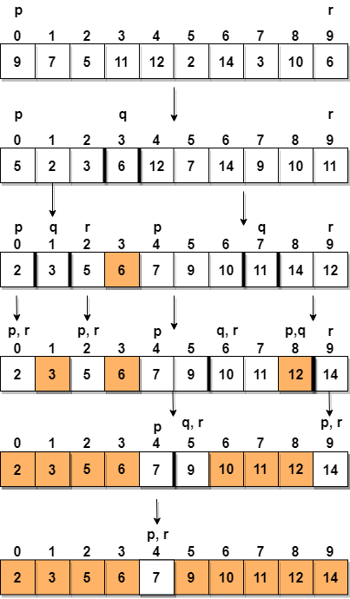

Slide 41
/* C implementation QuickSort */
#include<stdio.h>
// A utility function to swap two elements
void swap(int* a, int* b)
{
int t = *a;
*a = *b;
*b = t;
}
/* This function takes last element as pivot, places the pivot element at its correct position in sorted array, and places all smaller (smaller than pivot) to left of pivot and all greater elements to right of pivot */

Slide 42
int partition (int arr[], int low, int high) { int pivot = arr[high]; // pivot int i = (low - 1); // Index of smaller element for (int j = low; j <= high- 1; j++) { // If current element is smaller than or // equal to pivot if (arr[j] <= pivot) { i++; // increment index of smaller element swap(&arr[i], &arr[j]); } } swap(&arr[i + 1], &arr[high]); return (i + 1); }

Slide 43
/* The main function that implements QuickSort arr[] --> Array to be sorted, low --> Starting index, high --> Ending index */ void quickSort(int arr[], int low, int high) { if (low < high) { /* pi is partitioning index, arr[p] is now at right place */ int pi = partition(arr, low, high); // Separately sort elements before // partition and after partition quickSort(arr, low, pi - 1); quickSort(arr, pi + 1, high); } }

Slide 44
/* Function to print an array */ void printArray(int arr[], int size) { int i; for (i=0; i < size; i++) printf("%d ", arr[i]); printf("n"); } // Driver program to test above functions int main() { int arr[] = {10, 7, 8, 9, 1, 5}; int n = sizeof(arr)/sizeof(arr[0]); quickSort(arr, 0, n-1); printf("Sorted array: n"); printArray(arr, n); return 0; }

Slide 45
Merge Sort Algorithm

Slide 46
Merge Sort follows the rule of Divide and Conquer to sort a given set of numbers/elements, recursively, hence consuming less time.
Selection Sort and Insertion Sort, both of which have a worst-case running time of O(n²). As the size of input grows, insertion and selection sort can take a long time to run.
Merge sort , on the other hand, runs in O(n*log n) time in all the cases.
Divide and Conquer
There can break a single big problem into smaller sub-problems, solve the smaller sub-problems and combine their solutions to find the solution for the original big problem, it becomes easier to solve the whole problem.

Slide 47
In Merge Sort, the given unsorted array with n elements, is divided into n subarrays, each having one element, because a single element is always sorted in itself. Then, it repeatedly merges these subarrays, to produce new sorted subarrays, and in the end, one complete sorted array is produced.
The concept of Divide and Conquer involves three steps:
Divide the problem into multiple small problems.
Conquer the subproblems by solving them. The idea is to break down the problem into atomic subproblems, where they are actually solved.
Combine the solutions of the subproblems to find the solution of the actual problem.

Slide 48
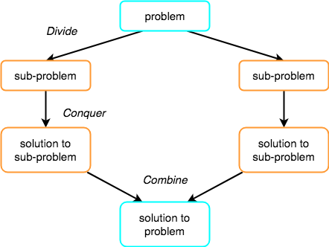

Slide 49
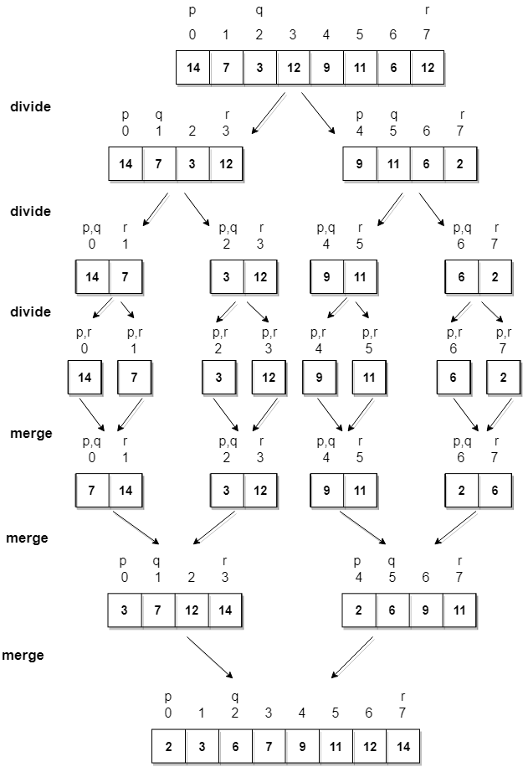

Slide 50
Following are the steps in merge sort :
Let us take a variable p and store the starting index of an array in this. And take another variable r and store the last index of array in it.
Then there find the middle of the array using the formula (p + r)/2 and mark the middle index as q, and break the array into two subarrays, from p to q and from q + 1 to r index.
Then we divide these 2 subarrays again, just like we divided our main array and this continues.
Once we have divided the main array into subarrays with single elements, then we start merging the subarrays.

Slide 51
Implementing Merge Sort Algorithm
/* a[] is the array, p is starting index, that is 0, and r is the last index of array. */
#include <stdio.h>
// lets take a[5] = {32, 45, 67, 2, 7} as the array to be sorted.
// merge sort function
void mergeSort(int a[], int p, int r)
{
int q;
if(p < r) { q = (p + r) / 2;
mergeSort(a, p, q);
mergeSort(a, q+1, r);
merge(a, p, q, r);
} }

Slide 52
// function to merge the subarrays
void merge(int a[], int p, int q, int r)
{
int b[5]; //same size of a[]
int i, j, k;
k = 0; i = p;
j = q + 1;
while(i <= q && j <= r)
{
if(a[i] < a[j])
{
b[k++] = a[i++]; // same as b[k]=a[i]; k++; i++;
}
else

Slide 53
{
b[k++] = a[j++];
} }
while(i <= q)
{
b[k++] = a[i++];
}
while(j <= r)
{
b[k++] = a[j++];
}
for(i=r; i >= p; i--)
{
a[i] = b[--k]; // copying back the sorted list to a[]
} }

Slide 54
// function to print the array
void printArray(int a[], int size)
{
int i;
for (i=0; i < size; i++)
{
printf("%d ", a[i]);
}
printf("\n");
}
int main()
{
int arr[] = {32, 45, 67, 2, 7};

Slide 55
int len = sizeof(arr)/sizeof(arr[0]);
printf("Given array: \n");
printArray(arr, len);
// calling merge sort
mergeSort(arr, 0, len - 1);
printf("\nSorted array: \n");
printArray(arr, len);
return 0;
}

